Slide 1

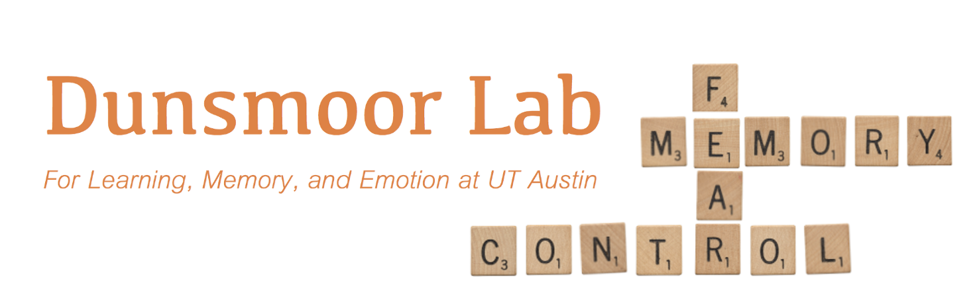
Dissociable neural reinstatement of emotional memories in human PFC
Augustin Hennings
Dunsmoor & Lewis-Peacock Labs
DAAMM 2020

Slide 2


Fear of dogs
Dogs are O.K.
Fear
Extinction
Fear often returns in novel contexts, or after a passage of time
Extinction is new learning, fear is not erased
How are these opposing associations organized in the brain?
Notes:
So I’m going to start day with something rather grim – lets say one day you are attacked by a dog. This negative experience could lead you to form a fear of all dogs, and this is a real world example of fear conditioning
A while later, you encounter a friendly dog, and you think hey ok dogs aren’t so bad. This is an example of fear extinction, and fear extinction serves as a laboratory model of exposure therapy, which is the most widely used treatment for trauma disorders
But we know that exposure therapy, or extinction, isn’t perfect – fear often returns in novel contexts, or after a passage of time. Since fear can return after extinction learning, extinction is then new learning which does not erase the original fear association.
Since both memories exist simultaneously, an adaptive memory system would segregate how these opposing associations are stored in the brain. What does this organization look like?
Rodent models have explored this question to great success, by looking for encoding specificity of these memories.

Slide 3
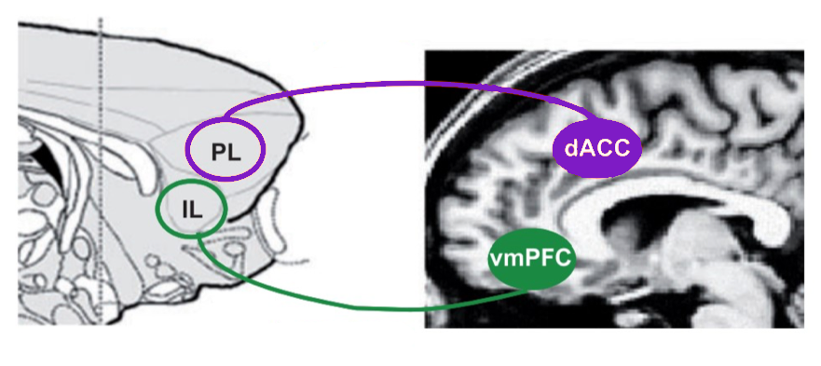


Encoding specificity - the neural circuits which encode a memory reactivate during retrieval
Fear and extinction engrams are stable and separable, in rodents
Fear
Extinction
Univariate approaches, no evidence of neural reinstatement in humans
Milad & Quirk, 2012, Annu Rev Psychol
Notes:
Encoding specificity is the the process in which the neural circuits which encode a memory reactivate during retrieval.
Rodent work has shown that fear and extinction engrams exist as stable and separable engrams that are reinstated to guide behavior. That is, there are distinct neural populations that are active during both encoding and retrieval of these associations.
From this work, we know that different regions of the rodent prefrontal cortex store engrams of opposite valence.
Specifically, fear engrams have been observed in the prelimbic cortex, and extinction engrams has been observed in the infralimbic cortex.
On the human side of things, there is converging evidence that the homologue structures, dorsal anterior cingulate cortex and the ventromedial prefrontal cortex, also code for memories of opposite value.
However most of this work in humans has only used univariate measures, and has not looked for evidence of neural reinstatement, or engram like-activity, across these two regions.

Slide 4
Are associative emotional memories organized the same way in humans as in rodents?
-Goal-
Identify separable neural reinstatement of fear and extinction across the PFC
Heathy
Fear
dACC
vmPFC
Neural Reinstatement
Extinction
Fear
Extinction
Fear
Extinction
Notes:
So the main question we are asking here, is are associative emotional memories organized the same way in humans there are in rodents?
So the goal of this project is to identify separable neural reinstatement of fear and extinction across the human PFC
This leads us to our specific hypothesis – due to the functional separation in affective processing in the PFC, there will be a double dissociation of emotional memory reinstatement. FULL STOP.
Specifically, we predict that fear memories are preferentially reinstated in the dACC, and extinction memories are preferentially reinstated in the vmPFC.
With more words transition from healthy prediction to PTSD prediction

Slide 5
Are associative emotional memories organized the same way in humans as in rodents?
-Goal-
Identify separable neural reinstatement of fear and extinction across the PFC
Heathy
PTSD
dACC
vmPFC
dACC
vmPFC
Is reinstatement dysregulated in individuals with PTSD?
?
Neural Reinstatement
Neural Reinstatement
Fear
Fear
Fear
Fear
Extinction
Extinction
Extinction
Extinction
Notes:
Additionally, we will considered whether individuals with PTSD display dysregulated reinstatement of emotional memories across these regions.
Individuals with PTSD have deficits in recalling extinction memories, and so reinstatement may also be dysregulated.

Slide 6



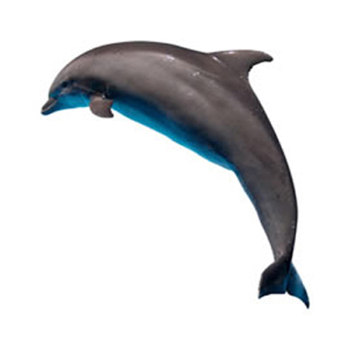


Category conditioning
Dunsmoor & Kroes, 2019, Curr Opin Behav Sci
Animals and Tools are conditioned stimuli (CS)
N = 24 healthy participants
N = 24 PTSD symptom individuals
Each unique episodic memory item is encoded with one emotional association
24hrs
Baseline
Acquisition
Extinction
Surprise Recognition
Memory Test
CS+, Animals
CS-
CS+
CS-, Tools
…
CS+
…
CS-
…
Def Old
Def New
Maybe Old
Maybe New
Specific category exemplars are never repeated
Notes:
In order to test our hypotheses, we employed an episodic-associative hybrid task.
In this task, participants form an emotional association to an entire sematic category, either animals or tools.
Each individual stimulus used is a unique category exemplar, that is not repeated. For example, even though they may see many different kinds of animals, there is only 1 dog shown during the entire experiment.
The task starts with a baseline phase, in which participants are passively viewing the stimuli. Next, during fear acquisition, images from one category are paired with a mild electric shock to the wrist. Extinction then immediately following fear acquisition, during which no shocks are delivered.
The following day, participants are placed back in the scanner and complete a surprise recognition memory test for the items they saw the previous day.
The end result of this task is that each episodic memory, or category exemplar, has 1 implicit emotional association (none, fear, or safety). That is, each stimulus is encoded in a distinct emotional context, based on the type of associative learning taking place.
So in this case, even though the dolphin and duck are both animals, one is associated with fear acquisition, and one is associated with extinction.
We collected data for 24 healthy participants, and 24 individuals with PTSD symptoms

Slide 7
Encoding Phase
Emotional Valence
Baseline
CS+
Acquisition
CS-
Extinction
ERS = pearson’s r (encoding, retrieval)
Emotional selectivity = CS+_{ERS} – CS-_{ERS}
N = 24 healthy participants
N = 24 PTSD symptom individuals

Slide 8
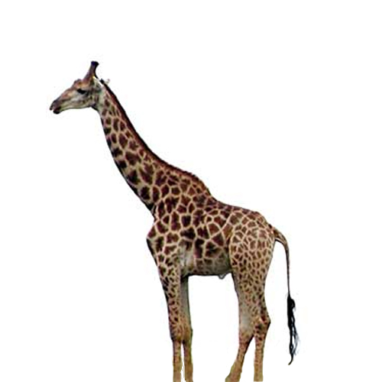
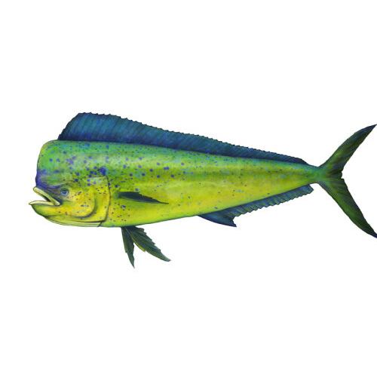

Encoding-Retrieval Similarity (ERS)
Correlation of neural activity from encoding to retrieval
Encoding
-24hrs-
Retrieval
Baseline
Baseline
Acquisition
Acquisition
Extinction
Extinction
Neural Activity
Low
High
Notes:
In order to measure neural reinstatement in humans, we use encoding-retrieval similarity, which is the correlation of neural activity from memory encoding to memory retrieval. Let me walk you through this.
During memory encoding, each item elicits a multivoxel pattern of activity. The next day, during the surprise memory test, each item again has its own unique pattern of activity. we can enter all of these patterns into a representational similarity matrix

Slide 9
Representational similarity matrix
Encoding
-24hrs-
Retrieval
Baseline
Pearson’s r
Baseline
Weak
Strong
Acquisition
Acquisition
Extinction
Extinction
Neural Activity
Low
High
Notes:
Here, each square represents the correlation of patterns of activity of different items, and from different time points.
What we are interested in is the correlation of same items to same items, for example dog to dog, from encoding to retrieval.

Slide 10
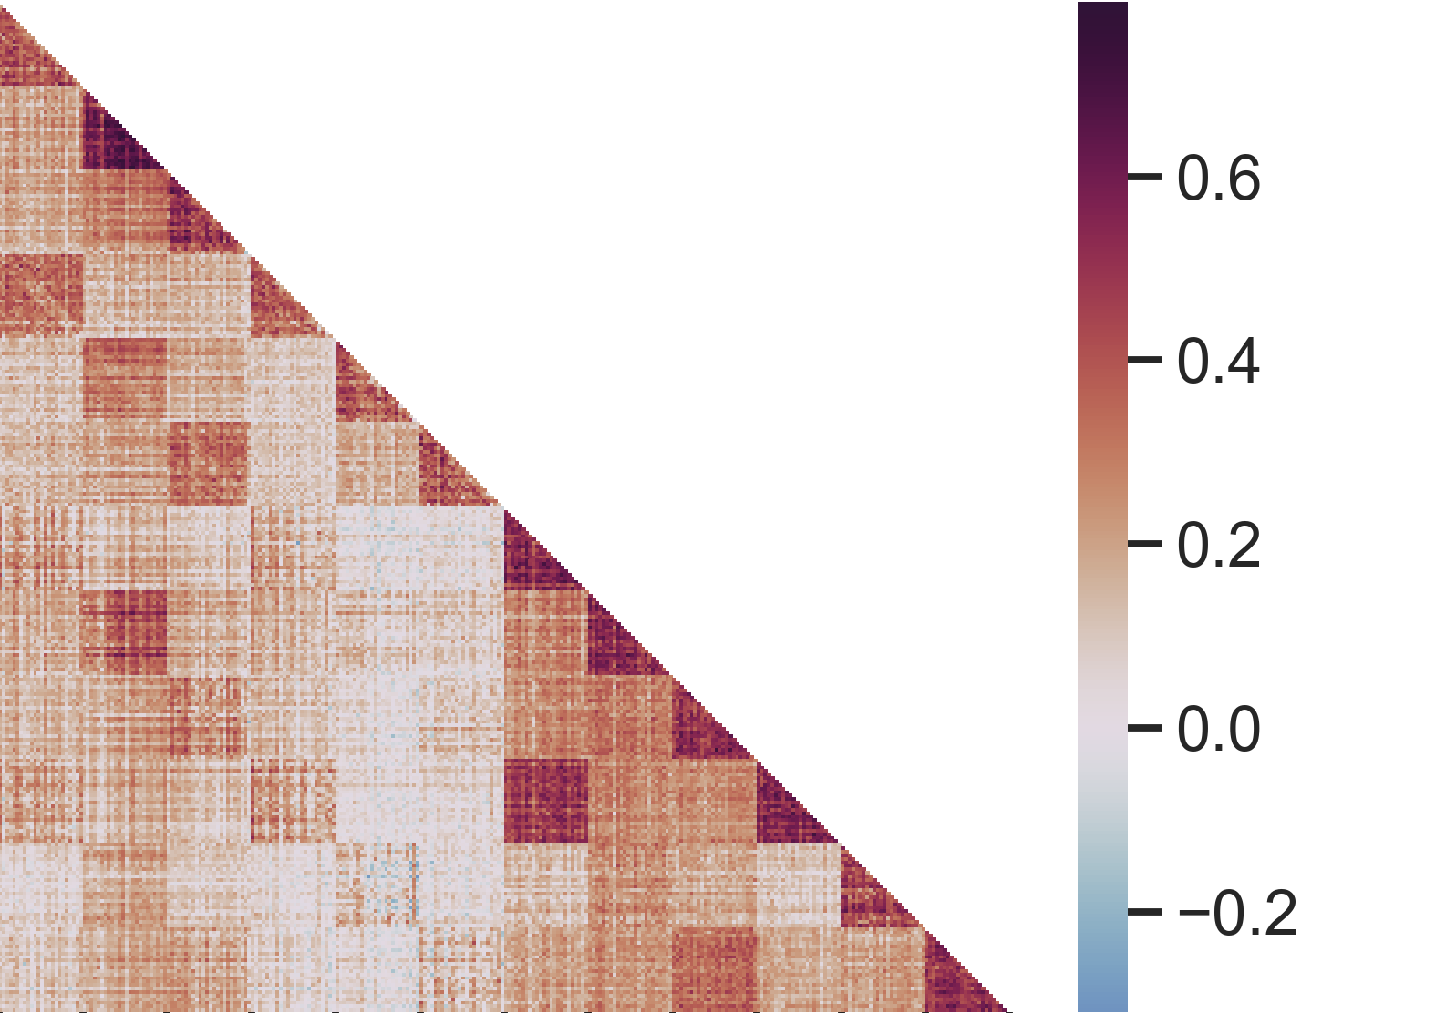
Emotional selectivity = CS+_{ERS} – CS-_{ERS}
Healthy - dACC
Encoding
Fisher Z(correlation)
Retrieval
Encoding
Retrieval
Notes:
Heres what the matrix looks like for real data, this is taken from our healthy subjects in the dACC.
As you can see, there is a lot of structure to this data, but again what we are interested in is this diagonal right here, comparing item to item from encoding to retrieval.
The last piece of this analysis is that we are interested in looking at emotional selectivity of this reinstatement, that is, where is reinstatement greater for CS+ items than CS-.
So we extract those values from each subjects similarity matrix, and take the difference of CS+ and CS- items that were encoded in the same phase, for our two ROIs.

Slide 11
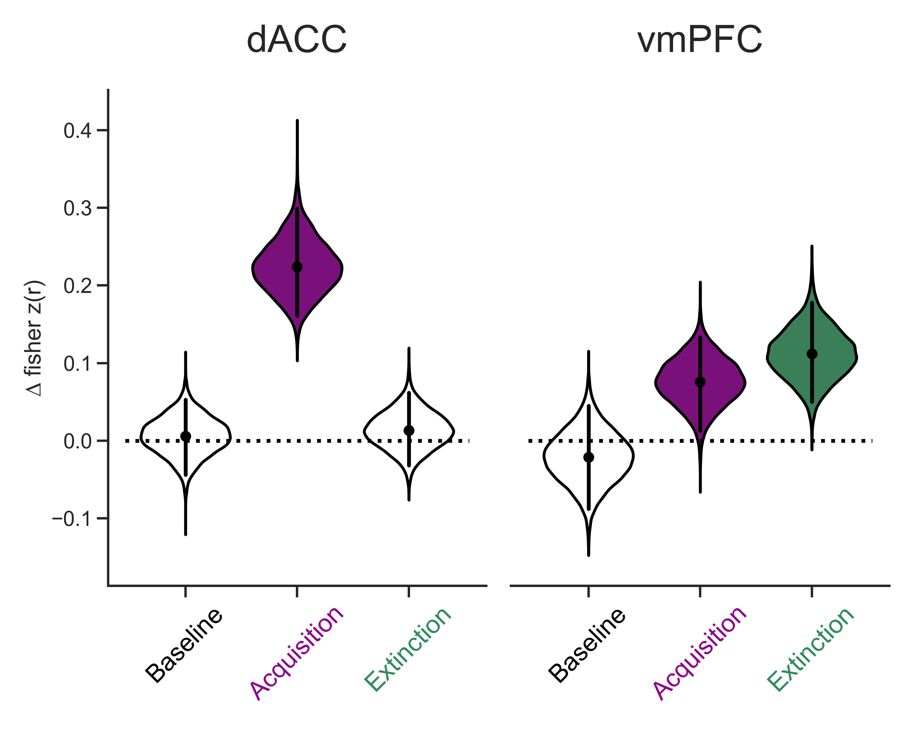
Emotional selectivity = CS+_{ERS} – CS-_{ERS}
Healthy
***
*
***
**
**
p < .05 * p < .01 ** p < .001 ***
Notes:
Here is that data.
The point and bars correspond to the mean and 95% confidence interval, and the violin is showing a bootstrap distribution of the difference, or distribution of the effect size.
So there is no significant emotional selectivity of reinstatement for baseline, which is good, since there was no emotional association when these items were encoded.
Looking at fear acquisition, we see that there is significant emotional reinstatement of fear memories in the dACC. And then looking at extinction, again there is no difference between CS+ and CS- reinstatement.
Looking at the vmPFC, again we see no significant emotional selectivity for reinstatement from baseline, we see some significant reinstatement for fear acquisition, and importantly significant emotional reinstatement for extinction memories.
If we compare across these two regions, we see that acquisition reinstatement is higher in the dACC, and extinction reinstatement is higher in the vmPFC.
This is exactly what we predicted, dissociable reinstatement of memories across these two regions

Slide 12
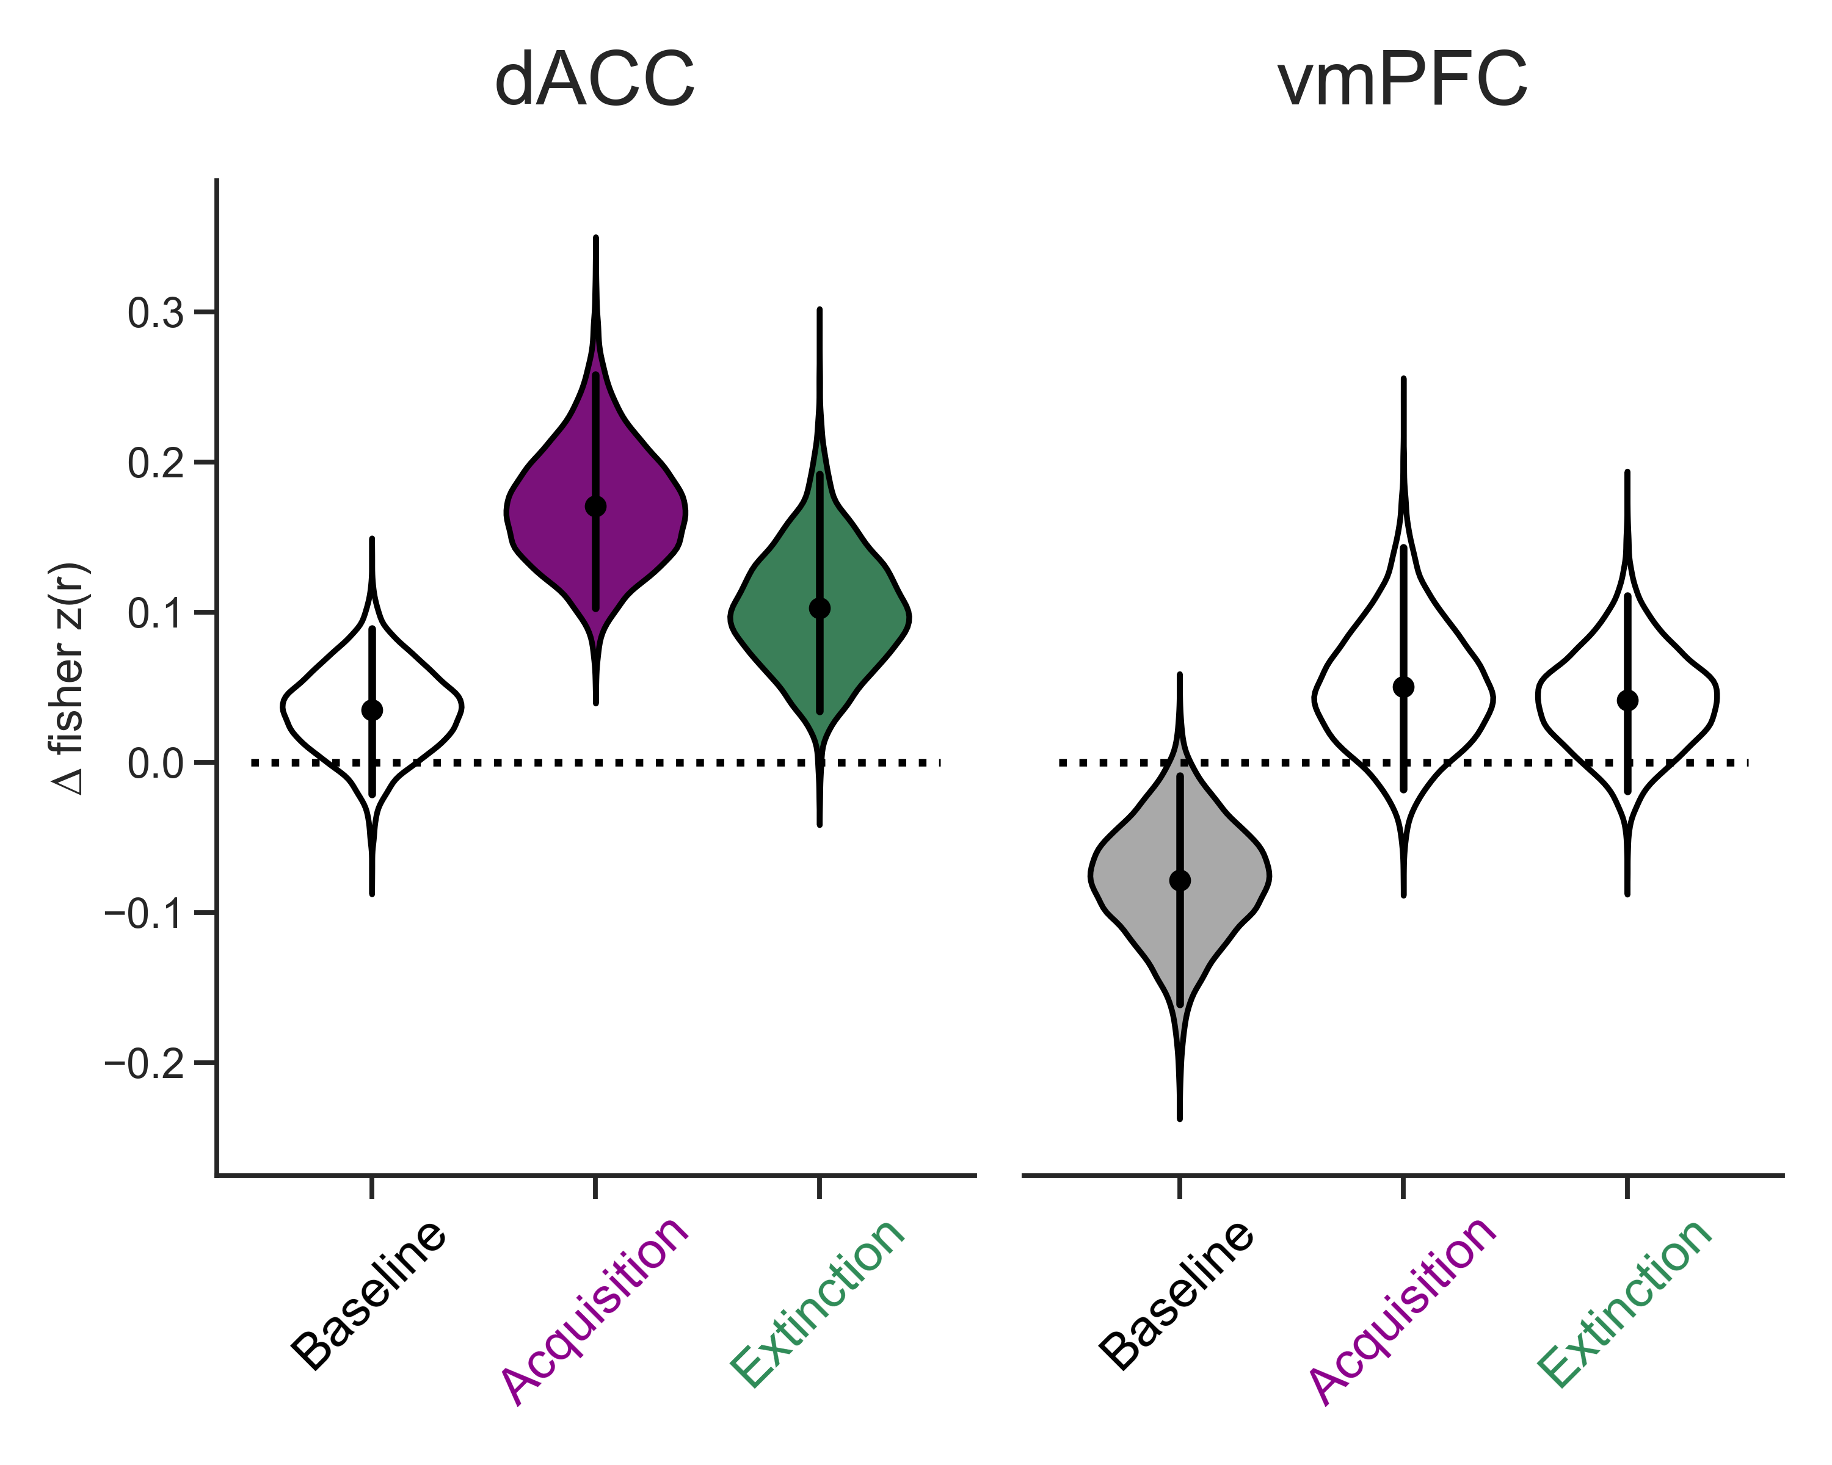
Emotional selectivity = CS+_{ERS} – CS-_{ERS}
Healthy
PTSD
*
***
*
*
***
***
p < .05 * p < .01 ** p < .001 ***
Notes:
(A > E in healthy dACC)
Next, lets look at the PTSD group. In the dACC, again we see no difference for baseline, and significant emotional reinstatement for acquisition. However, we also see significant emotional reinstatement of extinction memories in the dACC for the PTSD group.
In the vmPFC, we see no significant emotional reinstatement at all for either acquisition or extinction. There is something going on with baseline here, however this isn’t as interesting as the lack of reinstatement of extinction. Comparing across ROIs in the PTSD group, we see that fear reinstatement is stronger in the dACC.
So in PTSD, we have what looks like a misallocation of extinction memories to the dACC, they are being reinstated in a brain region that normally codes for fear.
I’d like to talk briefly about one more finding that is related to this dysregulation observed in PTSD

Slide 13
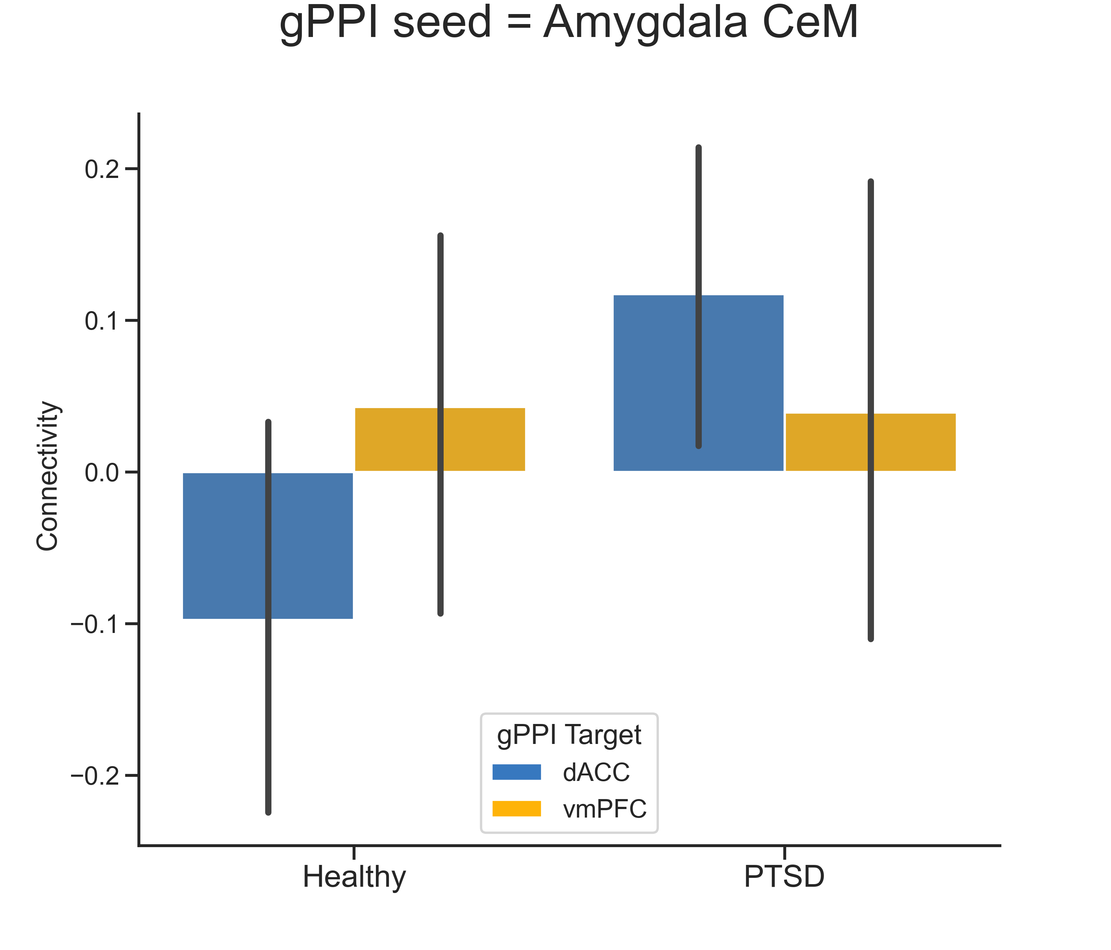
Fear and extinction processes depend on wider circuit
Amygdala CeM output controls fear expression
*
*
Functional connectivity (gPPI)
Extinction CS+ - Acquisition CS+
Mean +/- 95% CI
p < .05 *
Notes:
We know that fear and extinction processes depend on o wider circuit, including the amygdala and hippocampus.
Of those structures, we also know that the central nucleus of the amygdala is a critical structure in controlling fear expression.
We wanted to investigate how the central nucleus is functionally connected to the PFC, during the memory retrieval test.
Specifically, we wanted to look at if connectivity was different between the extinction CS+s, and the fear acquisition CS+s
So in the healthy adults, we see that there is no difference between extinction CS+ and acquisition CS+ connectivity in either ROI – so there is no difference in connectivity between these two conditions during the retrieval test
However, in the PTSD group, we see that the central nucleus is showing preferential connectivity with the dACC for extinction CS+s. That is, the amygdala and dACC are more connected when subjects encountered the CS+s from extinction compared to the CS+s from acquisition.
Comparing across groups, we see that this connectivity is significantly stronger in the PTSD group compared to the healthy group.

Slide 14
***
***
Dissociable reinstatement in PFC of
emotional memories in healthy adults
***
*
Individuals with PTSD misallocate
extinction memories to dACC
*
Extinction CS+ - Acquisition CS+
Individuals with PTSD show increased amygdala-dACC connectivity for extinction memories
Healthy
PTSD
Notes:
So in summary, in healthy adults we observed dissociable reinstatement of fear and extinction in the PFC. Fear high in the dACC, extinction high in the vmPFC.
In contrast, for individuals with PTSD, we observed significant reinstatement of both fear and extinction memories in the dACC.
Finally, we saw that individuals with PTSD show increased amygdala-dACC connectivity for extinction memories, relative to acquisition.
Really briefly, I’d like to talk about one other interesting result that might help explain whats going on with the PTSD group.

Slide 15




NIH R00MH106719 - Dunsmoor
CNS Summer Fellowship, F31MH124360 - Hennings

Slide 16
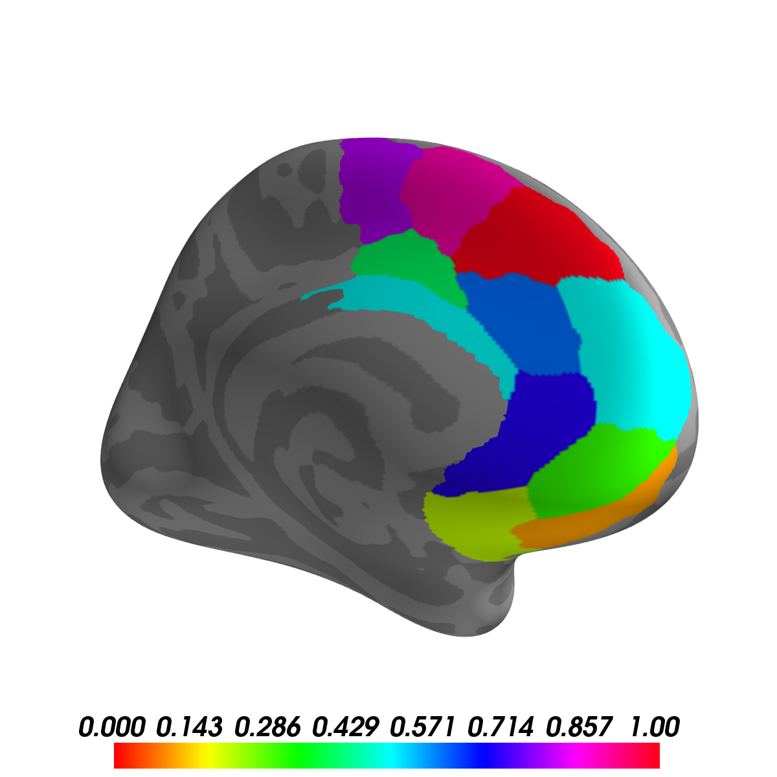
Brainnetome atlas – fine grained parcellation of cortex
11 bilateral ROIs from frontal & limbic lobes, along the midline

Slide 17
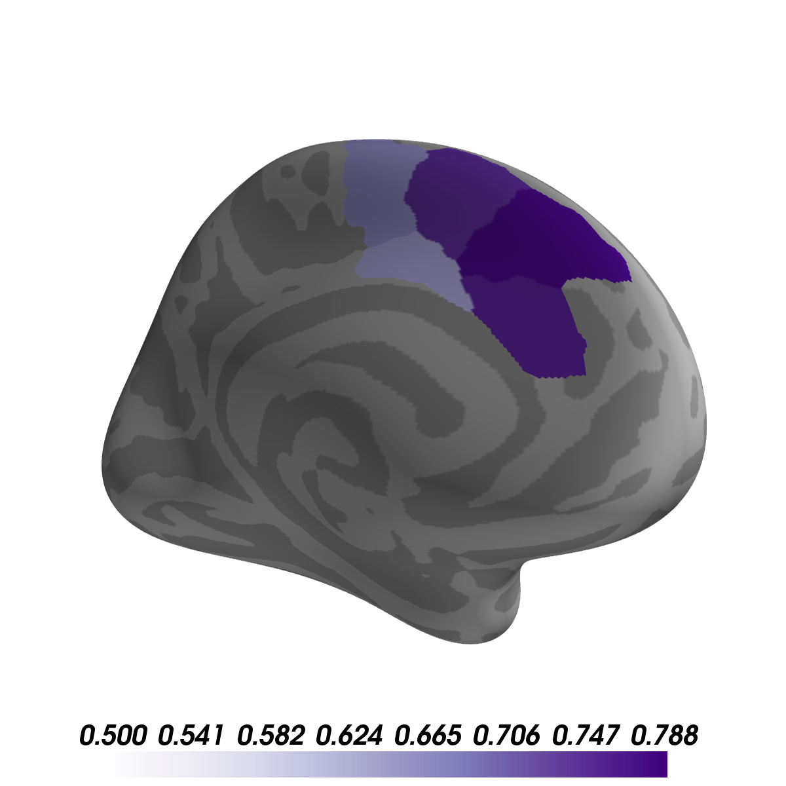
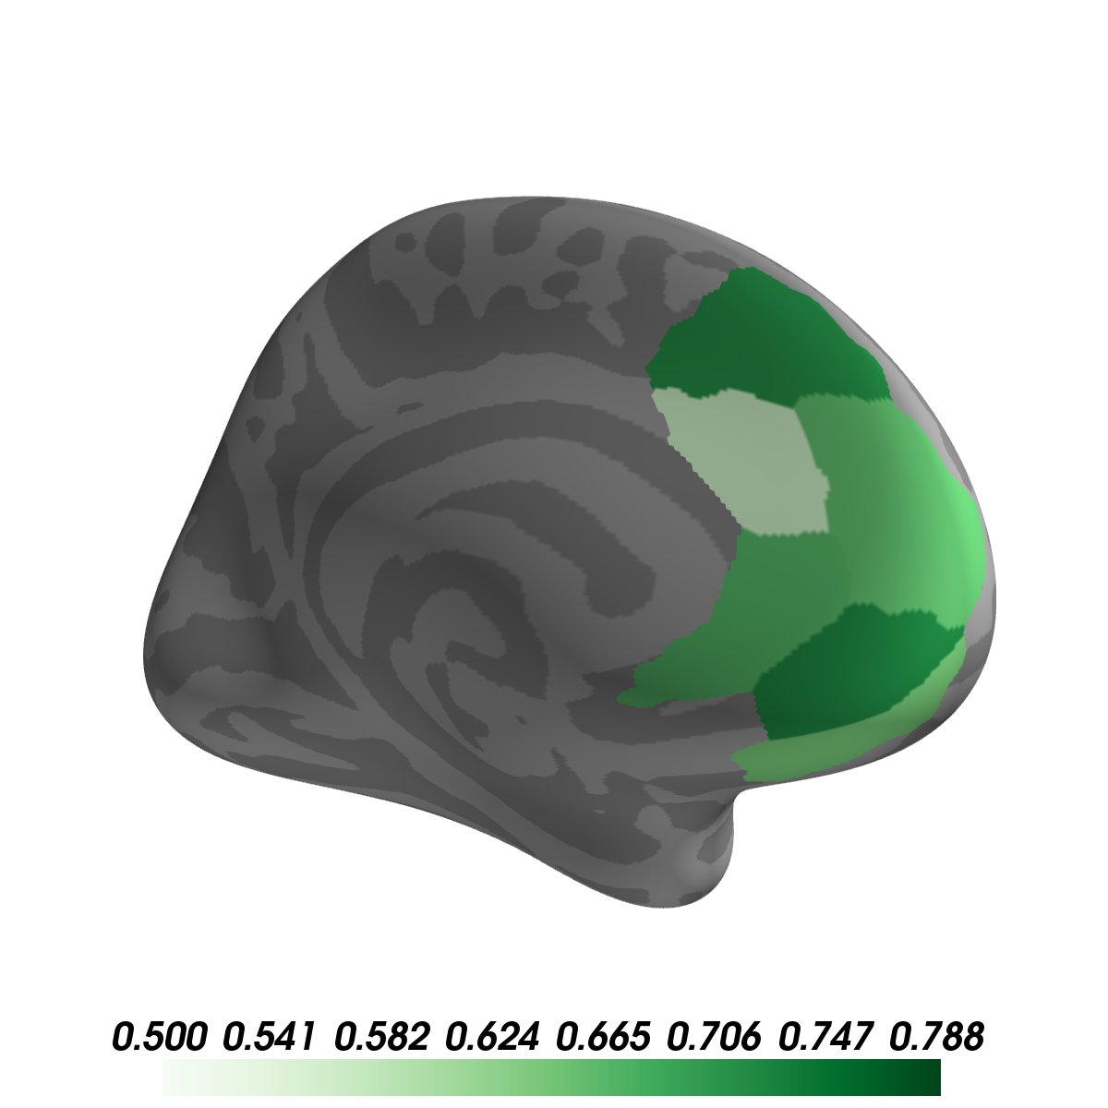
Healthy
Acquisition
Extinction
No significant emotional ERS for items encoded during Baseline
effect size
effect size
1 sided Wilcoxon sign-ranked test (CS+_{ERS} > CS-_{ERS})
Each image threshold at p<.05 FDR corrected

Slide 18
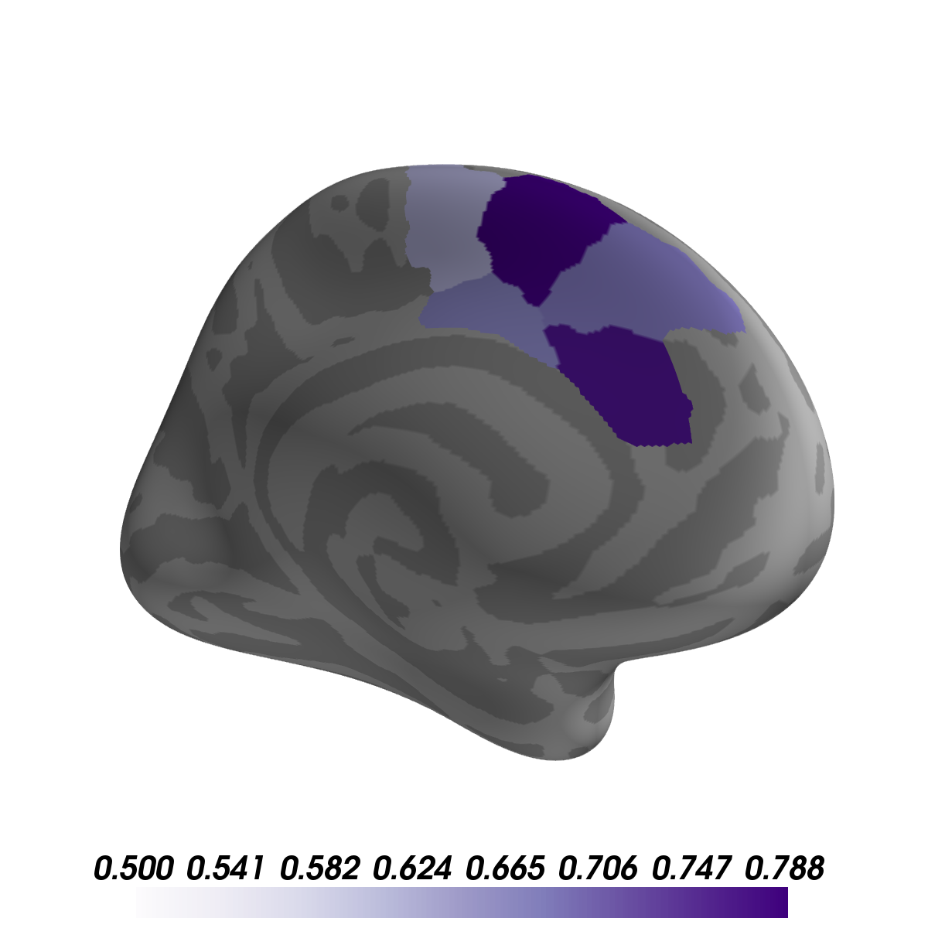
Healthy
PTSS
Acquisition
No significant emotional ERS for items encoded during Baseline
No significant emotional ERS for items encoded during Extinction
Each image threshold at p<.05 FDR corrected
effect size

Slide 19
Healthy
PTSS
Dissociable reinstatement in PFC of
emotional memories in healthy adults
Individuals with PTSD do not reinstate extinction memories
How did we get here?
Are there differences in encoding?

Slide 20
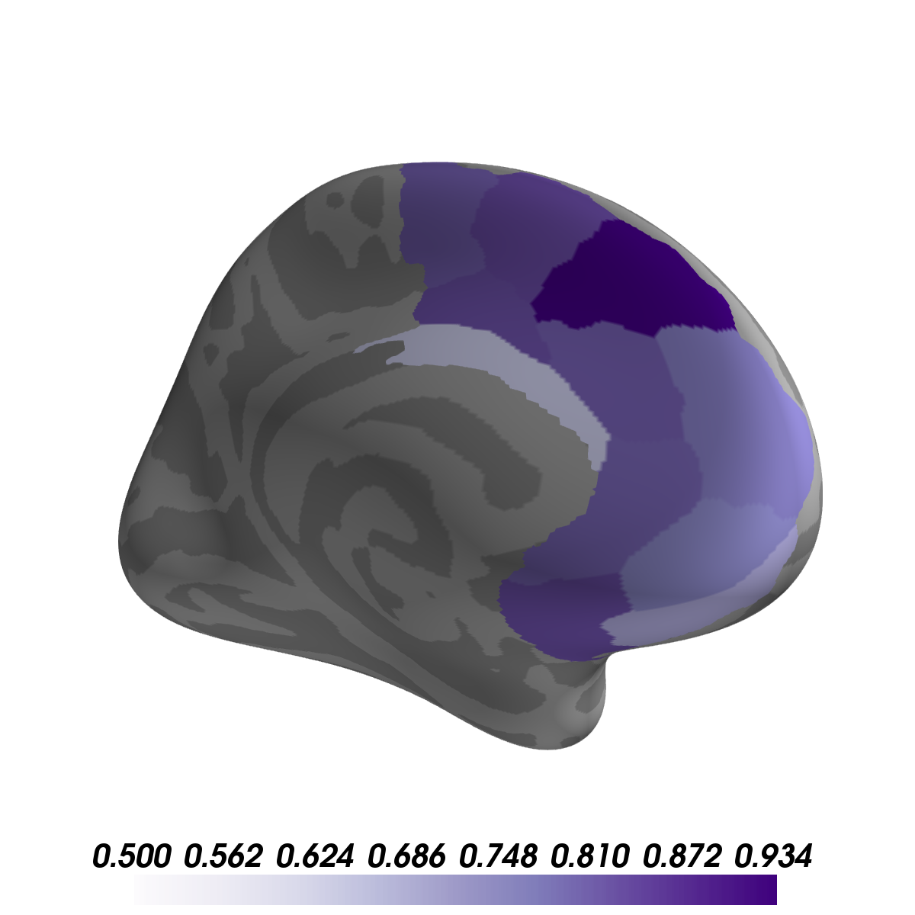
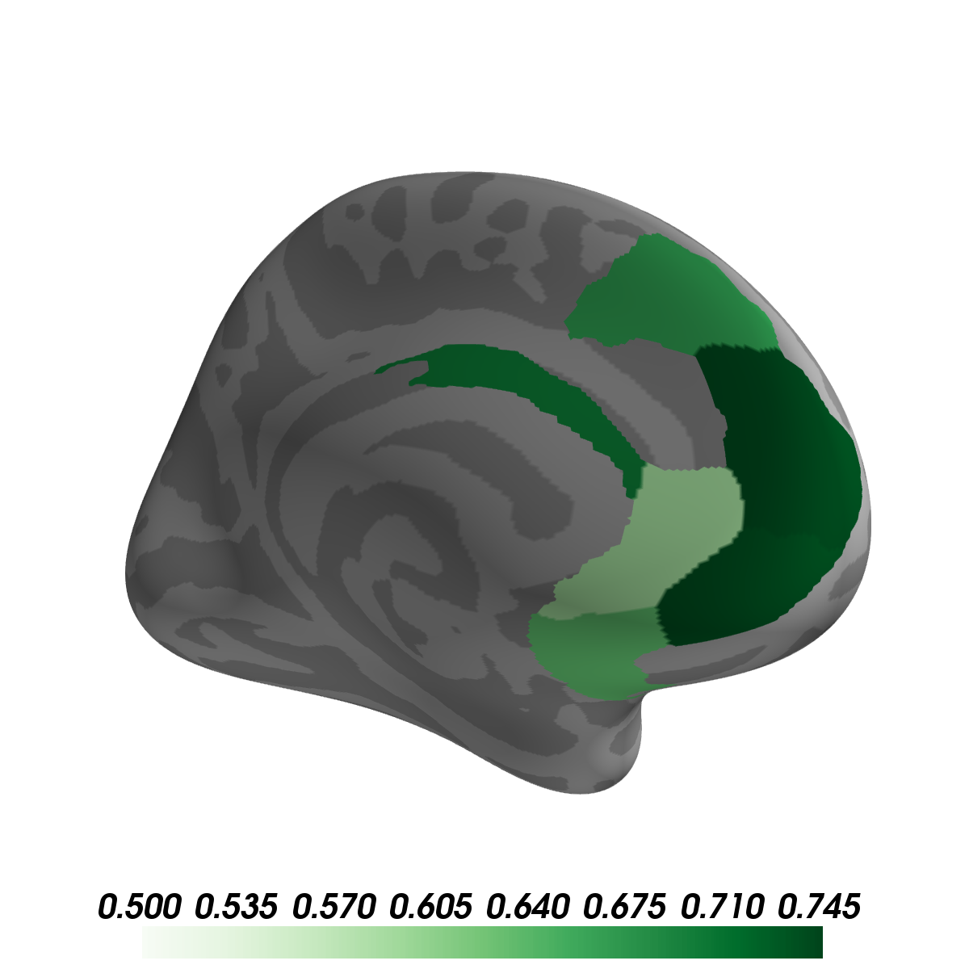
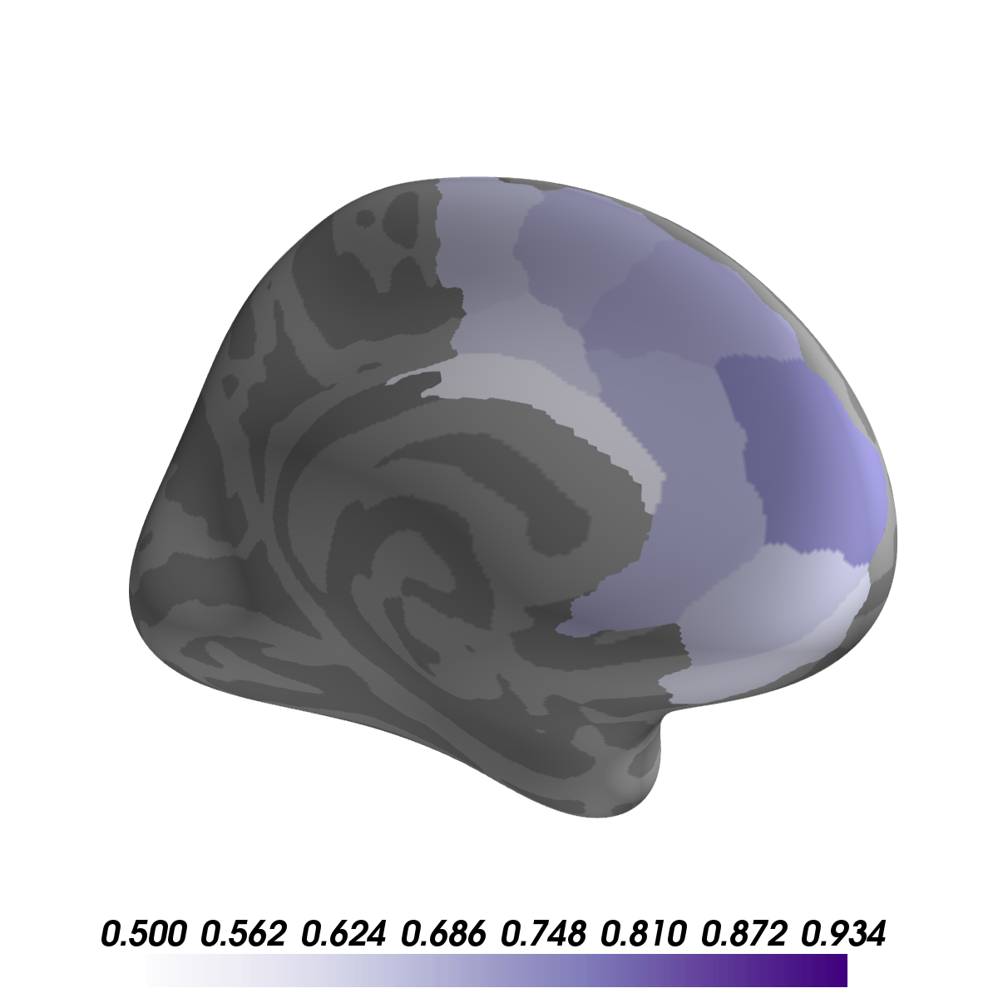
Encoding similarity = pearson’s r (encoding, encoding)
Emotional selectivity = CS+_{similarity} – CS-_{similarity}
Healthy
PTSS
Acquisition
Extinction
Acquisition
No significant emotional encoding similarity during Baseline
No significant emotional encoding similarity during Baseline
effect size
No significant emotional encoding similarity during Extinction
Are there differences in encoding?
p<.05 FDR corrected

Slide 21
Healthy
PTSS
PFC is sensitive to emotional valence during fear acquisition
In healthy adults, ventral PFC is sensitive to both fear and extinction
Does emotional sensitivity at encoding predict subsequent reinstatement?

Slide 22
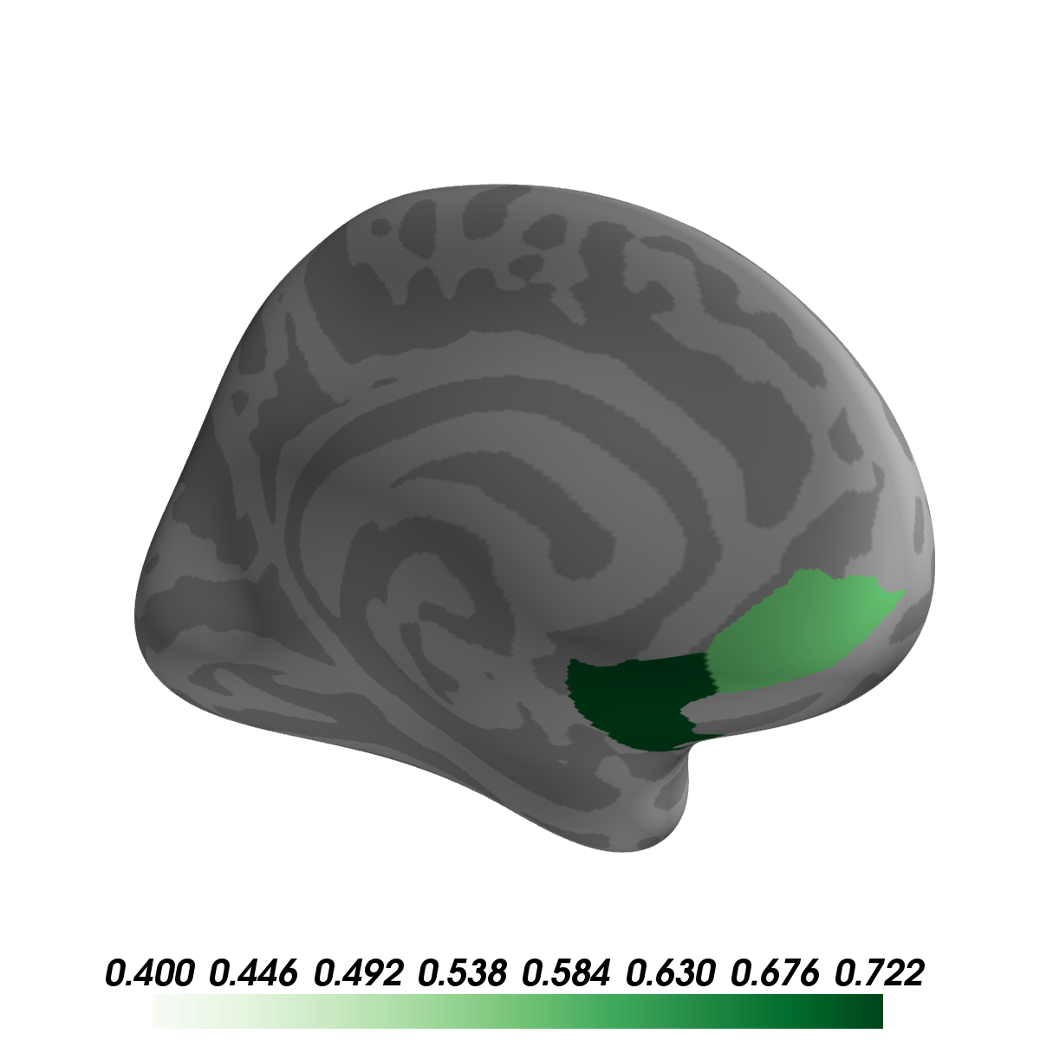
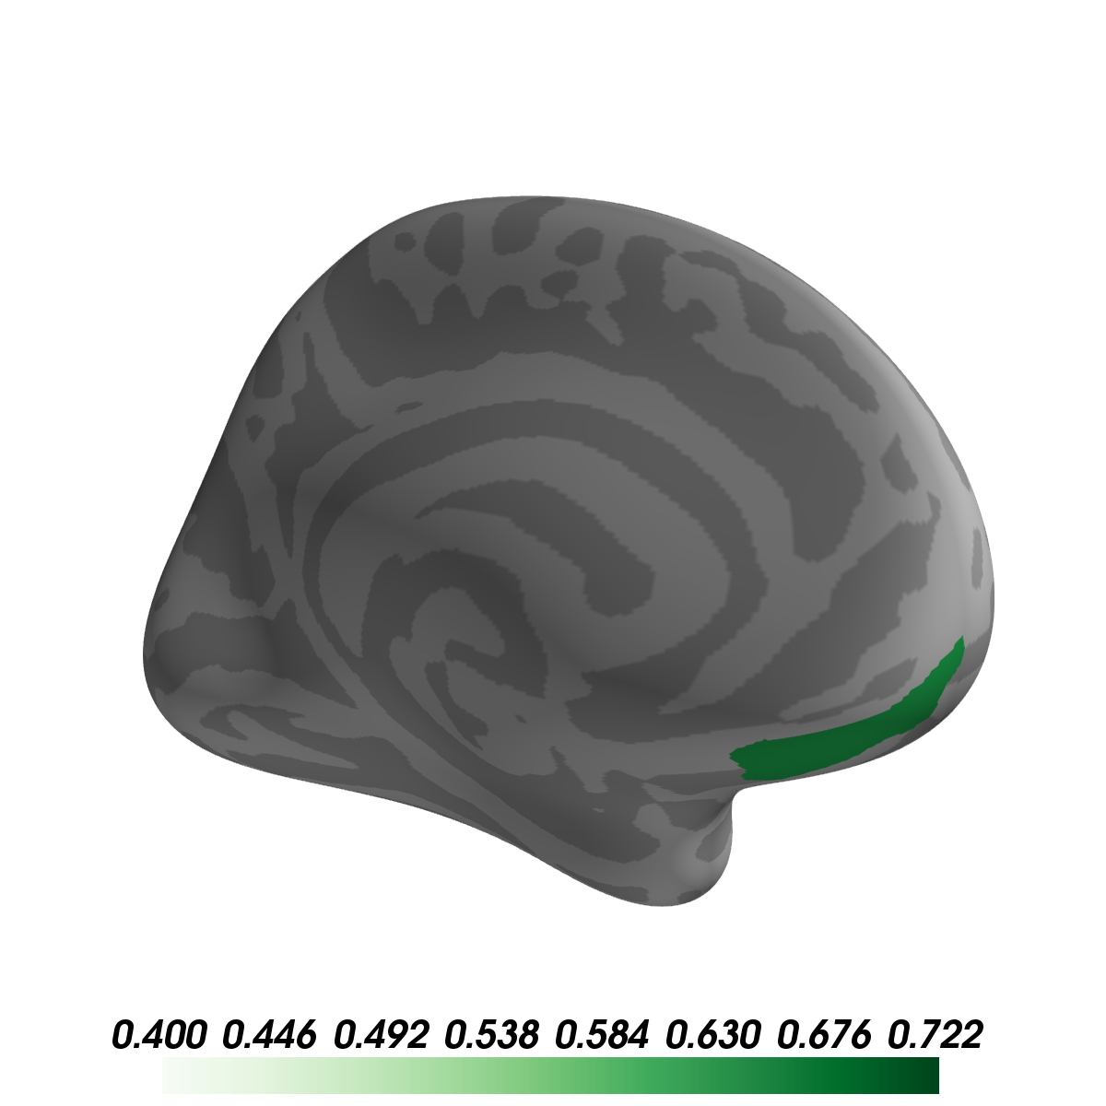
Healthy
PTSS
Extinction
Extinction
No significant correlation for acquisition
Pearson’s r
Pearson’s r
Does emotional sensitivity at encoding predict subsequent reinstatement?
p<.05 FDR corrected

Slide 23
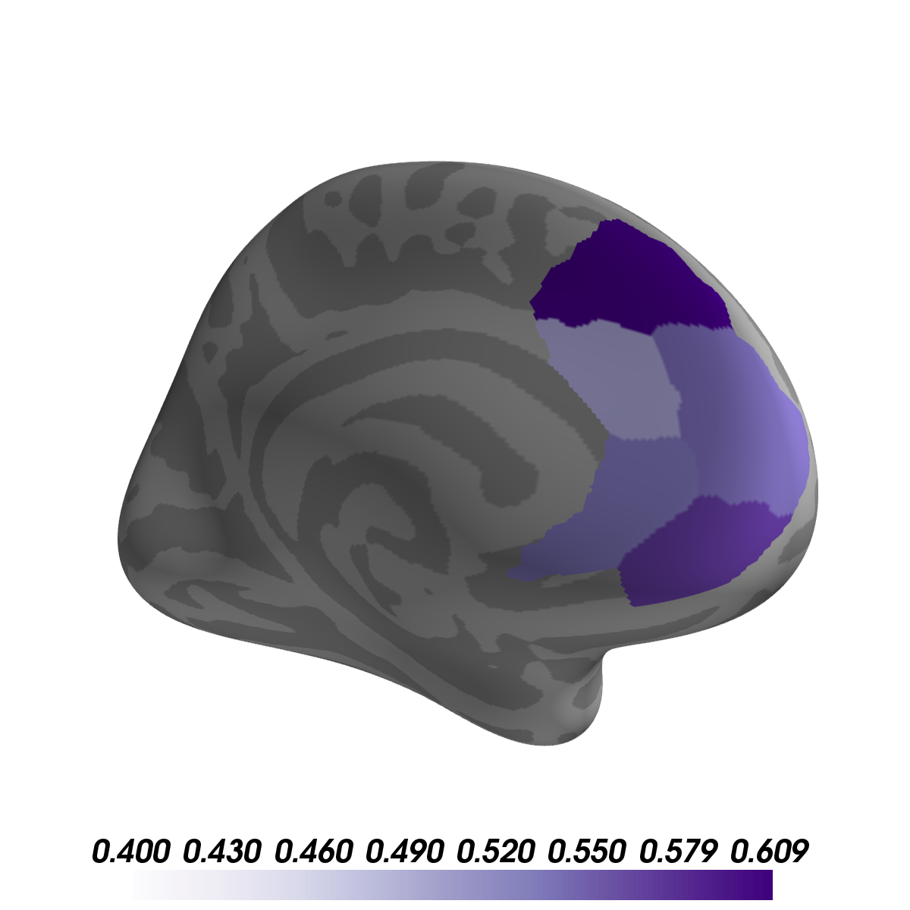
Healthy
PTSS
Extinction
Acquisition
Extinction
Pearson’s r
Pearson’s r
Pearson’s r
In PTSS, encoding similarity predicts misallocated fear reinstatement in ventral PFC
In both groups, encoding similarity predicts extinction reinstatement in ventral PFC

Slide 24
Summary
Emotional encoding
Neural reinstatement
In healthy adults, ventral PFC is sensitive to both fear and extinction
Dissociable reinstatement in PFC of
emotional memories in healthy adults
Emotional encoding sensitivity predicts extinction memory reinstatement in healthy and PTSS

